Slide 2

05
-06
Lesson 05-06
Counting: Balls and Boxes

Slide 3
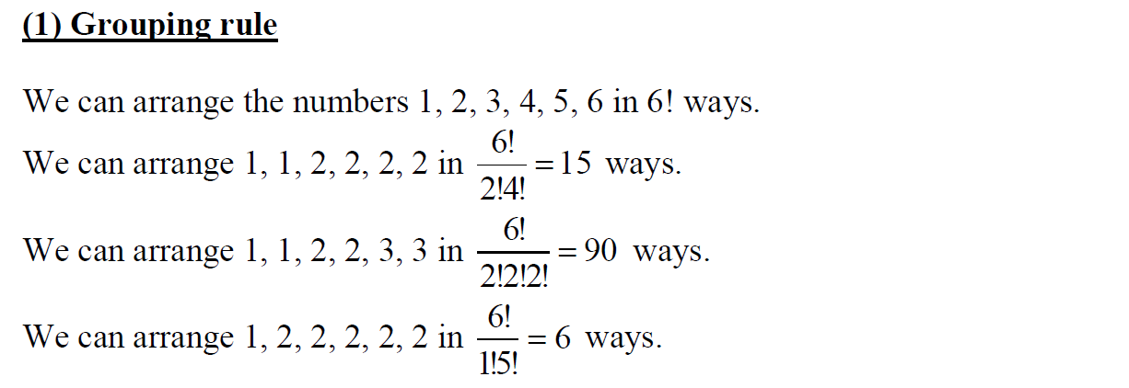
Lead in

Slide 4

Lead in

Slide 5

Lead in

Slide 6

Lead in

Slide 7

Lead in

Slide 8
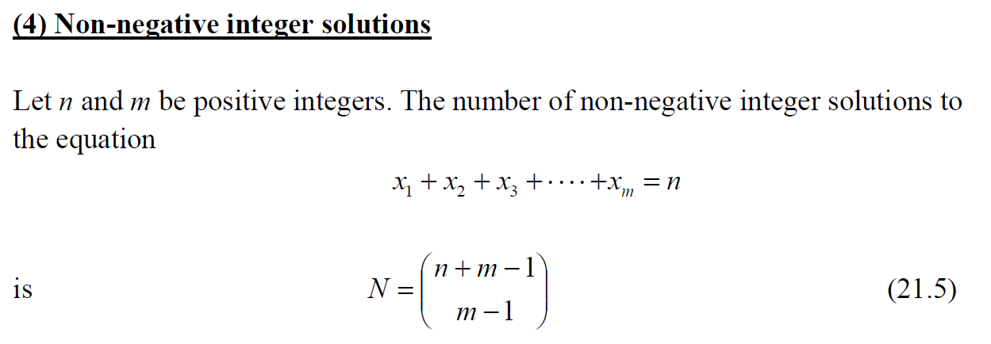
Lead in

Slide 9
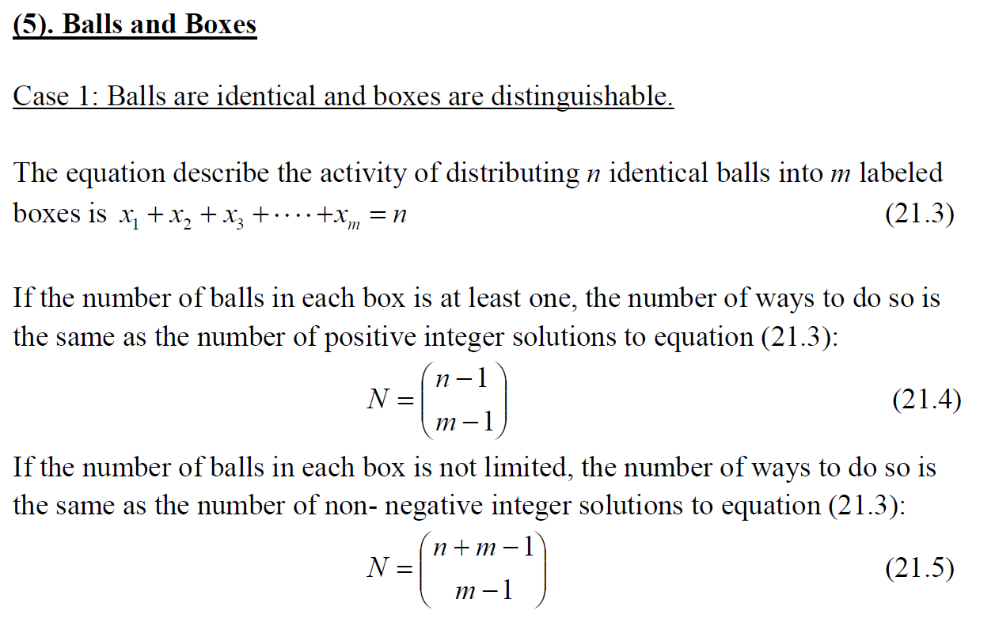
Lead in

Slide 10

Lead in

Slide 11
Chapter 1
Balls are identical and boxes are distinguishable

Slide 12

Example

Slide 13

Example

Slide 14

Example

Slide 15

Example

Slide 16

Example

Slide 17

Example

Slide 18

Example

Slide 19

Example

Slide 20
Chapter 2
Balls are distinguishable and boxes are distinguishable

Slide 21

Example

Slide 22

Example

Slide 23

Example

Slide 24

Example

Slide 25

Example

Slide 26

Example

Slide 27

Example

Slide 28

Example

Slide 29

Example

Slide 30
Chapter 3
Past Problems of AMC/AIME

Slide 31

Example

Slide 32

Example

Slide 33

Example

Slide 34

Example

Slide 35
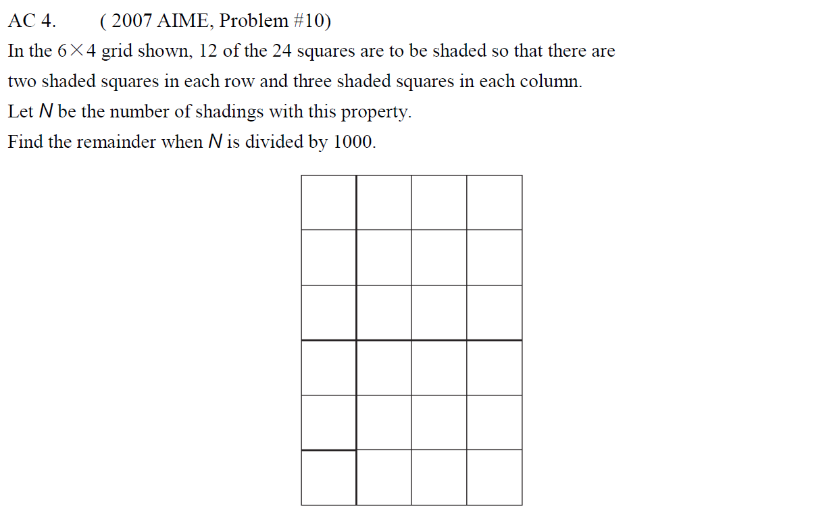
Example

Slide 36

Example

Slide 37

Example

Slide 38

Example

Slide 39
See You Next Time!

